Slide 1
Dataset
The dataset contains 9358 instances of hourly averaged responses from an array of 5 metal oxide chemical sensors embedded in an Air Quality Chemical Multisensor Device
Contains 14 attributes

Slide 2
Clustering Algorithms
For the purpose of clustering, date and time are removed from the features set. In this case, we have 9357 instances and 13 attributes.
Algorithms which calculate the distance, works better with low dimension, in high dimensions, different between the distances are insignificant
Plots are based on the first and second features

Slide 3
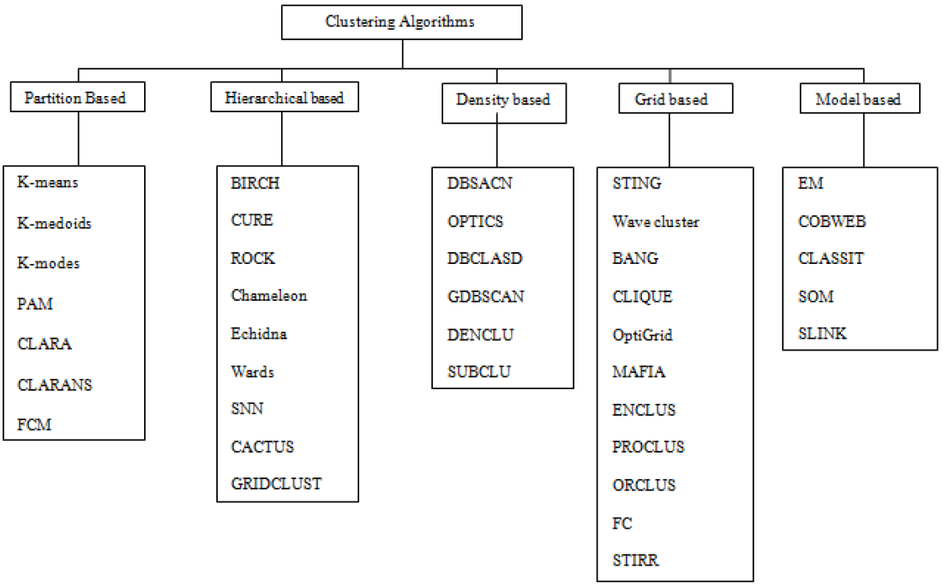
Clustering Algorithms

Slide 4
Clustering Algorithms
Partition based: K-means clustering
Hierarchical based: Simple Hierarchical clustering
Density based: DBSCAN
Grid based: Clique
Model based: EM clustering

Slide 5
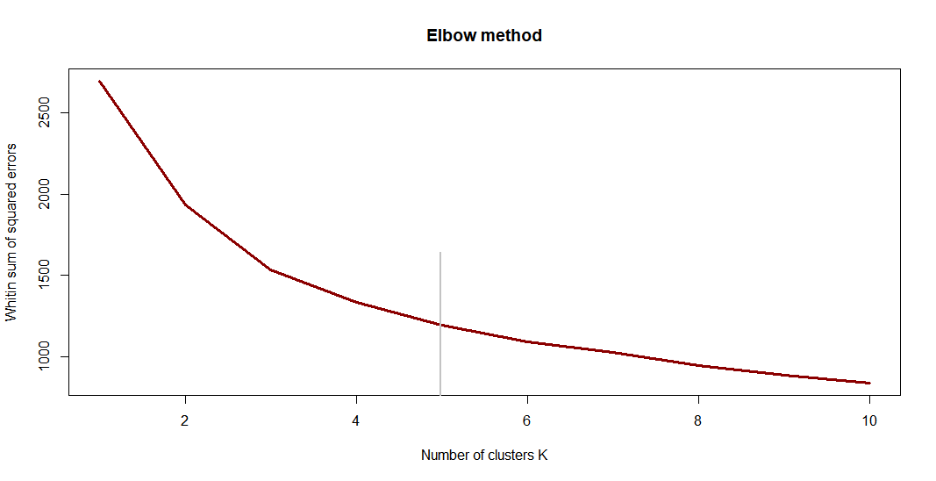
K-means
1 parameter (Number of Clusters)
Suitable for Low Dimension
How to determine the best number of clusters?

Slide 6
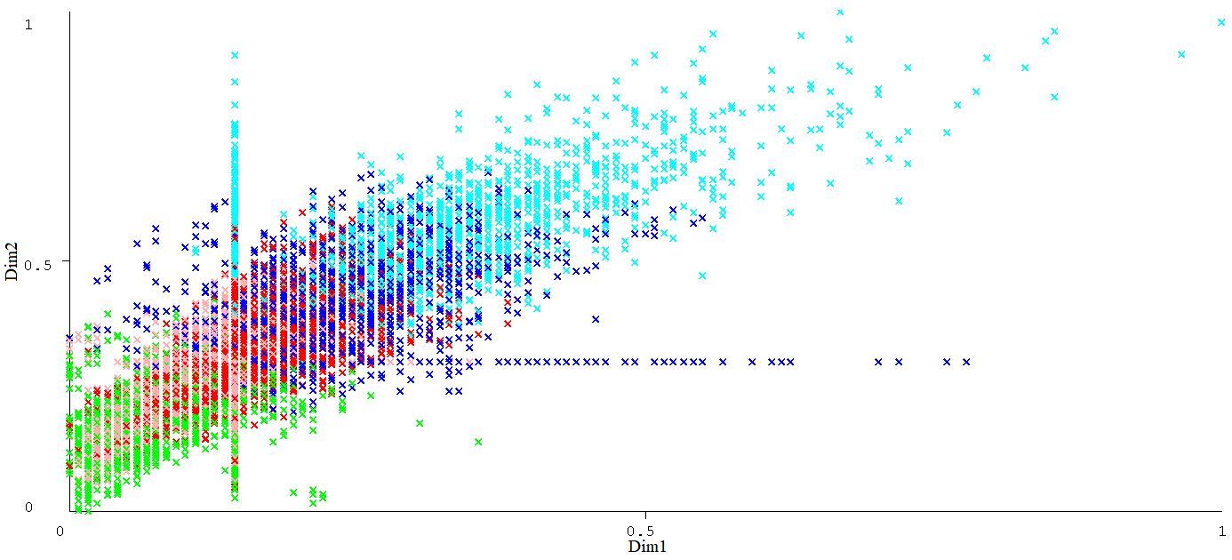
K-means
Clustered Instances
0 1495 (16%)
1 2120 (23%)
2 1859 (20%)
3 1321 (14%)
4 2562 (27%)

Slide 7
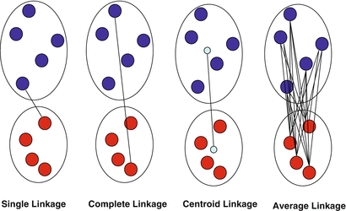
Hierarchical Clustering
1 parameter (Number of Clusters)
Suitable for Low Dimension
Cut the tree to produce 4 clusters
(Liu P., Si Y., 2014)

Slide 8
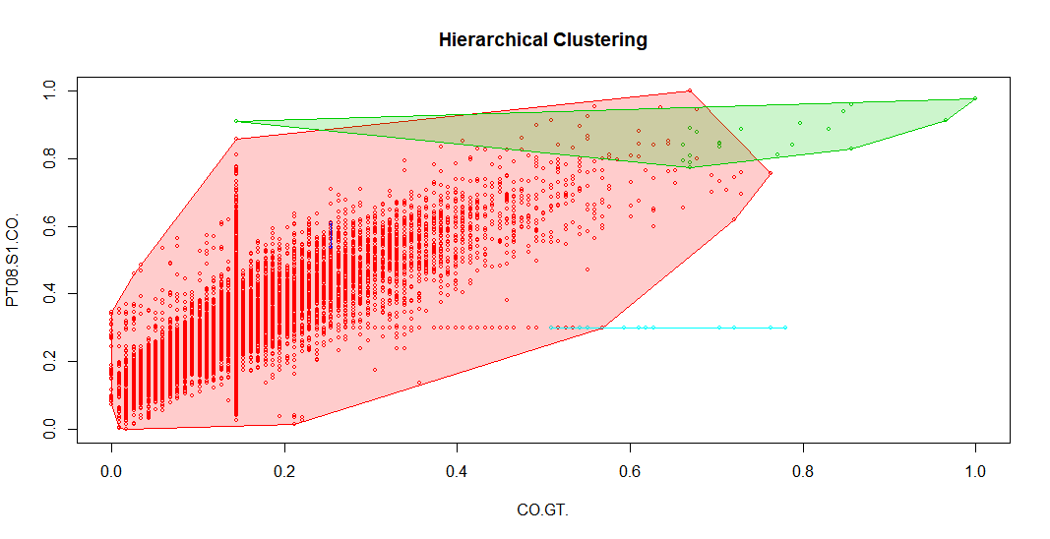
Average Linkage
Clustered Instances
1 9318
2 22
3 2
4 15

Slide 9
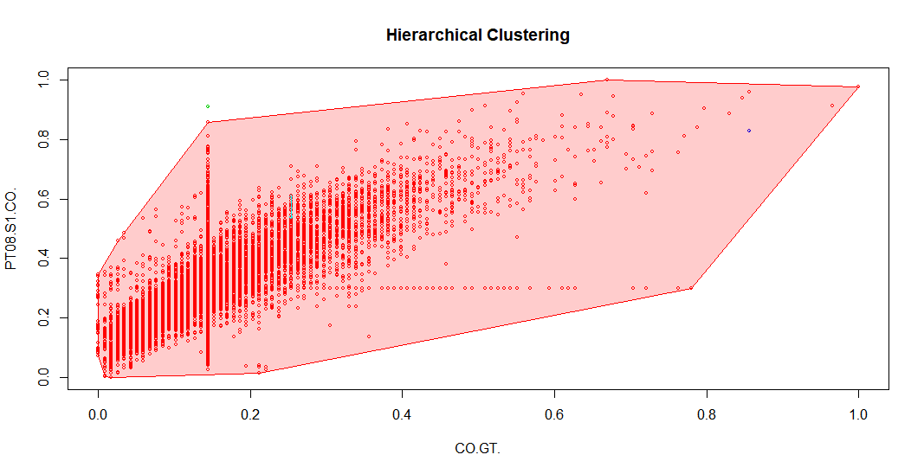
Single Linkage
Clustered Instances
1 9353
2 1
3 1
4 2

Slide 10
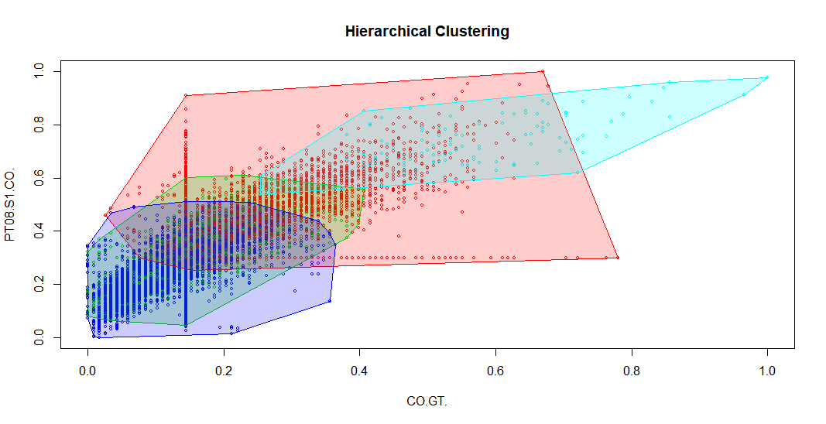
Complete Linkage
Clustered Instances
1 2366
2 3279
3 3598
4 114

Slide 11
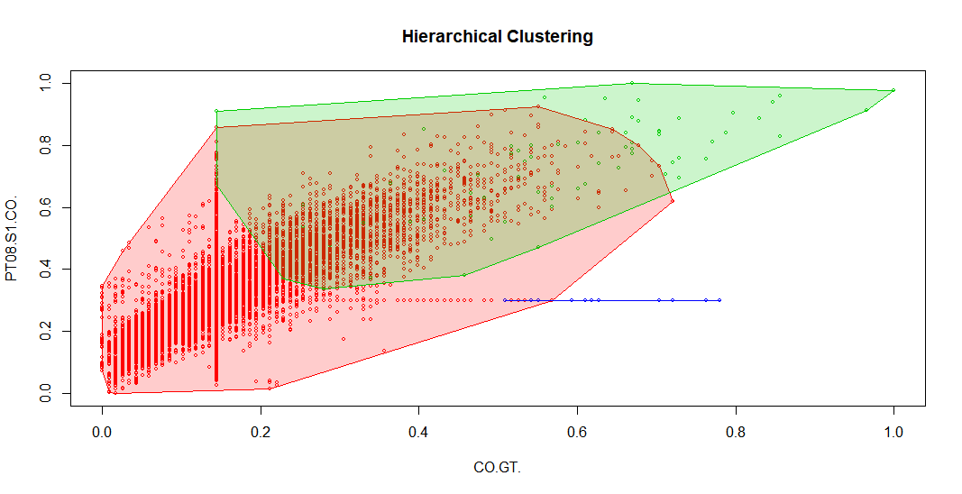
Centroid Linkage
Clustered Instances
1 9269
2 72
3 15
4 1

Slide 12
Hierarchical Clustering
Average Linkage
Single Linkage
Complete Linkage
Centroid Linkage

Slide 13
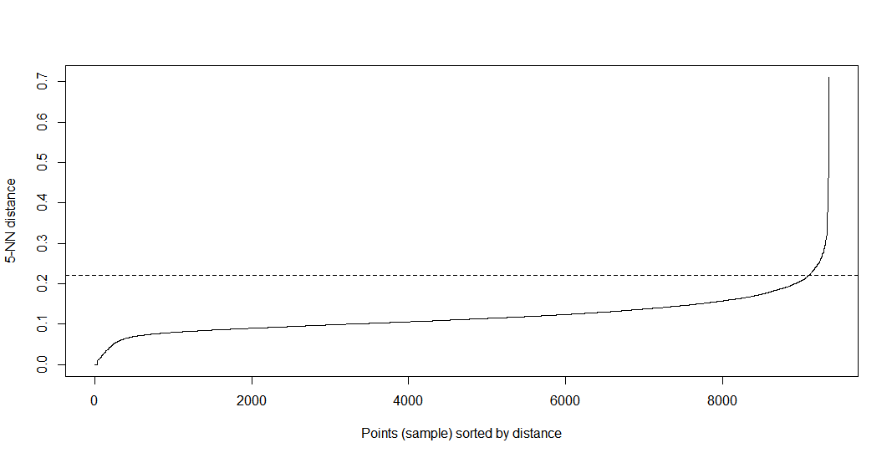
DBSCAN
2 parameter (MinPts, eps)
Suitable for Low Dimension
Knee method for determining the optimal eps value with respect to a predefined MinPts.

Slide 14
DBSCAN
2 parameters (MinPts, eps)
Suitable for Low Dimension
Knee method for determining the optimal eps value with respect to a predefined MinPts.

Slide 15
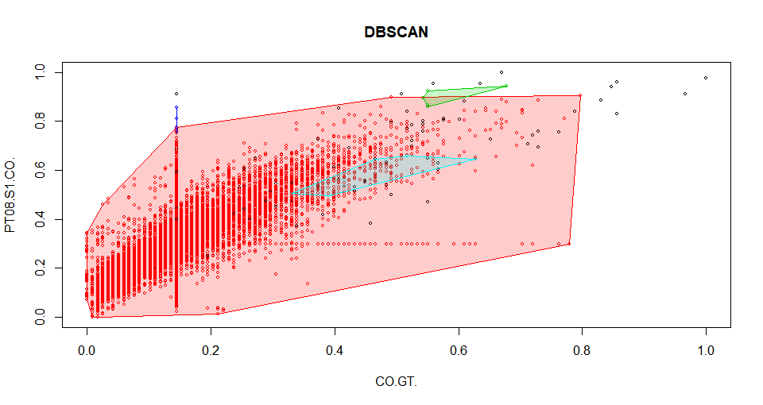
DBSCAN
dbscan Pts=9357 MinPts=5 eps=0.22
0 1 2 3 4
border 89 103 4 0 6
seed 0 9147 1 5 2
total 89 9250 5 5 8

Slide 16
Clique
2 parameters (Number of Intervals, Density Threshold)
Suitable for Low Dimension
Overlapping results
Clustered Instances
0 1 dimensional subspace 6812
1 1 dimensional subspace 9069
2 1 dimensional subspace 6762
3 1 dimensional subspace 7157
4 2 dimensional subspace 6791
5 2 dimensional subspace 6707
6 2 dimensional subspace 6918

Slide 17
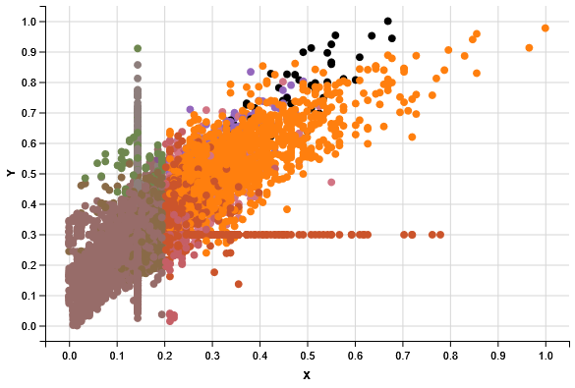
Clique

Slide 18
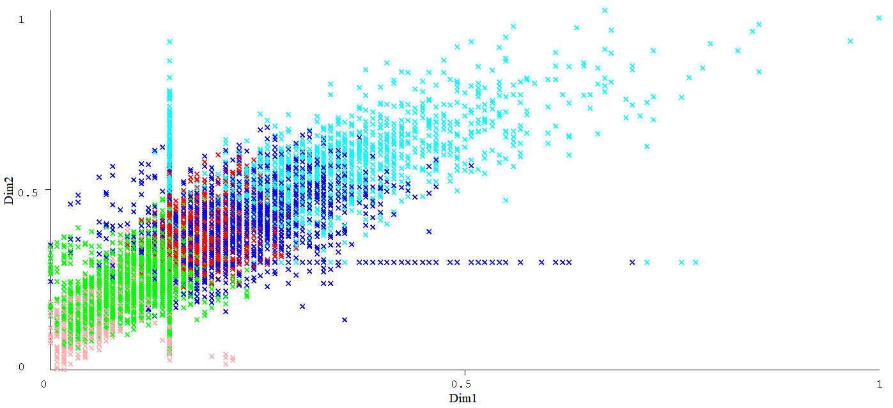
EM Clustering
1 parameter (Number of Clusters)
Suitable for High Dimension
Clustered Instances
0 1781 (19%)
1 1177 (13%)
2 3910 (42%)
3 1386 (15%)
4 1103 (12%)

Slide 19
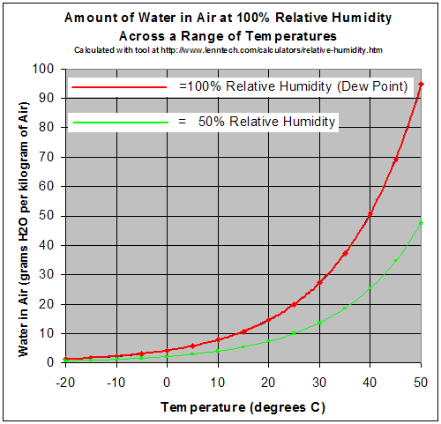
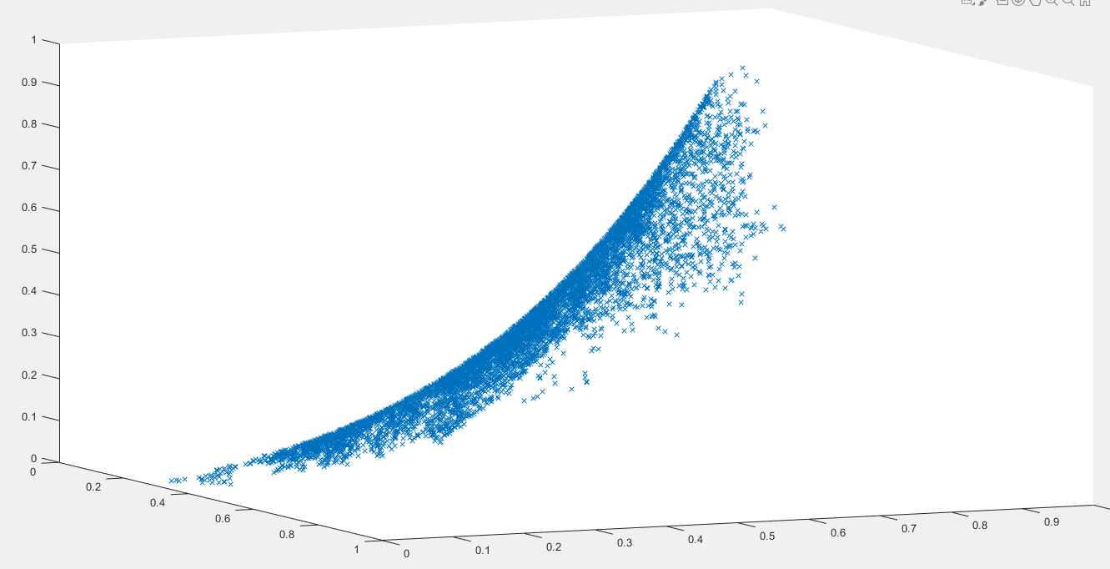
Redundant Features
Some of the features are redundant:
Humidity
Temperature
Relative Humidity

Slide 20
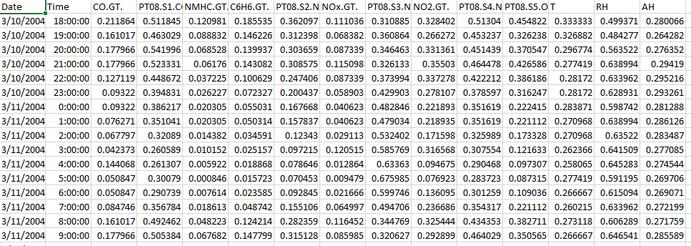
Prediction using neural networks
Data Points are sequences of time (average hourly)
Interesting Task: prediction of trend and next values (using the past)
Assuming no time warp

Slide 21
Missing data for prediction
Missing data as part of input features
When replaced by median only increases error slightly
Missing data as part of target
When replaced by median increase error and lowers prediction quality by a considerable amount
Solution: Using last known value instead of median or removing it from error calculation

Slide 22
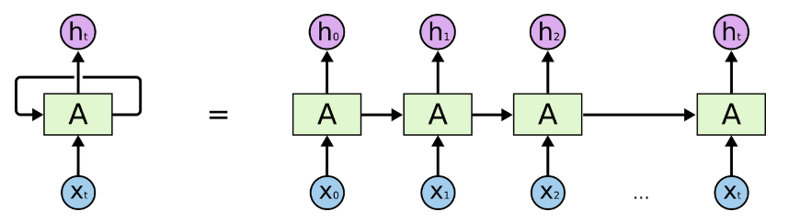
Modelling: Recurrent Neural Networks
What kind of neural network?
How they train it?

Slide 23
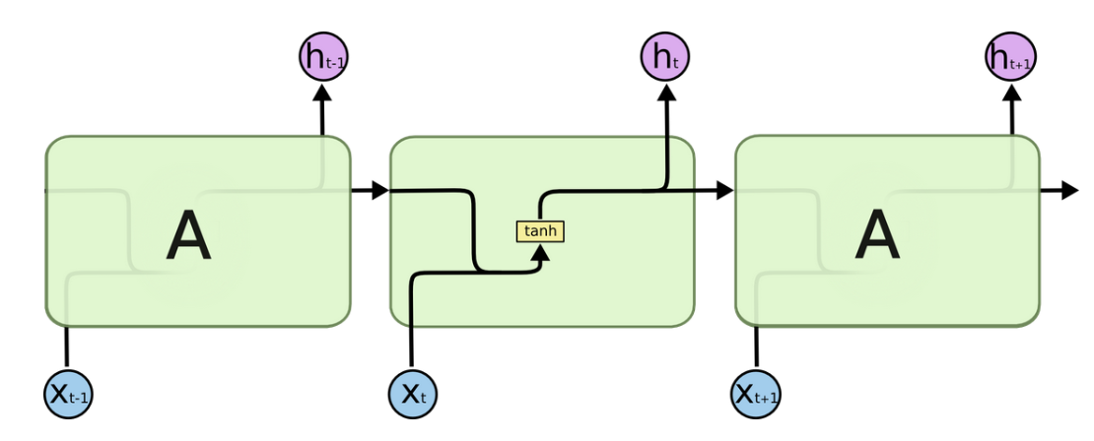
Modelling: Recurrent Neural Networks
Why it’s not enough?

Slide 24
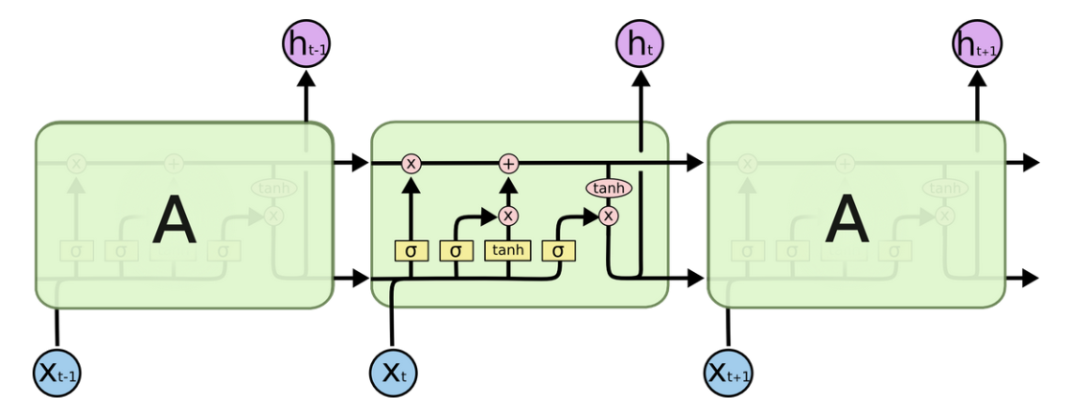
Modelling: LSTM
Understanding LSTMs

Slide 25
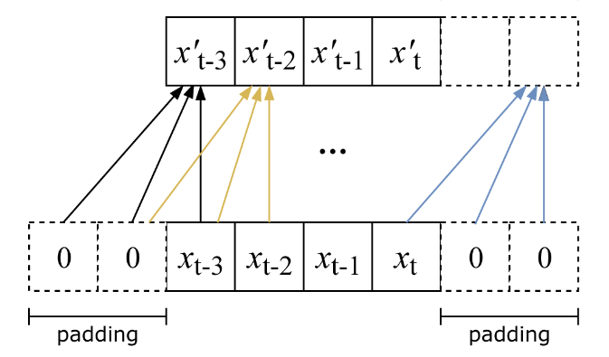
Modelling: CNNs
CNNs for prediction of time sequences
No looking at the future
Limited memory from the past
Easier to train

Slide 26
Analysis
Comparison of accuracies
Which model is better?
The importance of the past
how much is two days ago relevant for today’s prediction?
Importance of the parameters
Is Co2 more important in N2 or something else is more important?
Is there a cycle that the network can use (especially CNN)?
7days? 24hours?

Slide 27
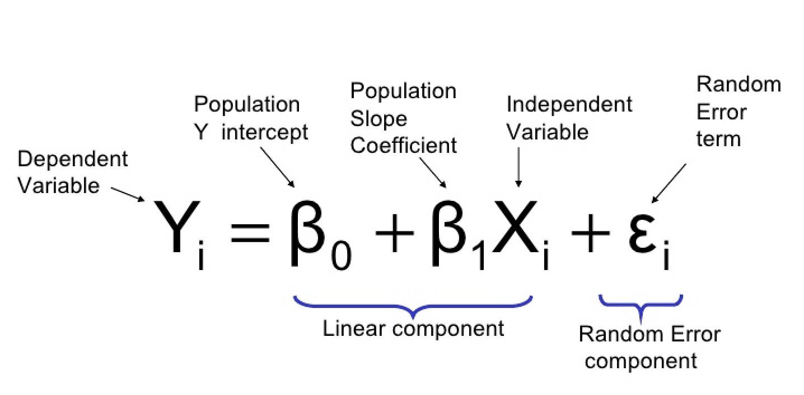
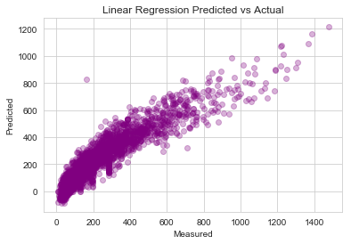
Regression Analysis: Linear Regression
Linear regression attempts to model the relationship between two variables by fitting a linear equation to observed data.
To predict the presence of nitrogen oxides in air.

Slide 28
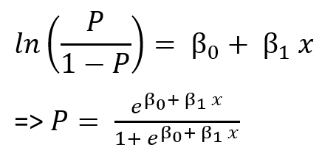
Classification model : Logistic Regression
Logistic regression is used to describe data and to explain the relationship between one dependent binary variable and one or more nominal, ordinal, interval or ratio-level independent variables.
Accuracy : 79.390
Confusion Matrix :
Actual Predicted | 1 | 0
1 | 1296 | 628
0 | 624 | 1153

Slide 29
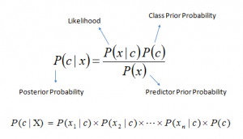
Classification model : Naïve Bayes
Gaussian NB implements Gaussian Naïve Bayes algorithm for classification. The likelihood of features is assumed to be Gaussian
Accuracy : 58.54 %
Confusion Matrix :
Actual Predicted | 1 | 0
1 | 1296 | 628
0 | 624 | 1153

Slide 30
Classification model : Decision Tree
Decision Tree Classifier is capable of performing multiclass classification on a dataset.
Accuracy : 68%
Confusion Matrix :
Actual Predicted | 1 | 0
1 | 1108 | 511
0 | 503 | 961

Slide 31
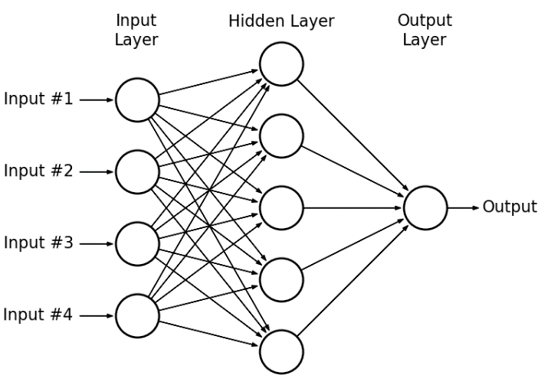
Classification model : Multilayer Perceptron
Multi-layer Perceptron can be viewed as a logistic regression classifier where the input is first transformed using a learnt non-linear transformation.
Accuracy : 71.11%
Confusion Matrix :
Actual Predicted | 1 | 0
1 | 726 | 893
0 | 385 | 1079

Slide 32

Ensemble method : Random Forest Classifier
A random forest is a meta estimator that fits a number of decision tree classifiers on various sub-samples of the dataset and uses averaging to improve the predictive accuracy and control over-fitting.
Accuracy : 72.70
Confusion Matrix :
Actual Predicted | 1 | 0
1 | 1183 | 421
0 | 421 | 1060

Slide 33
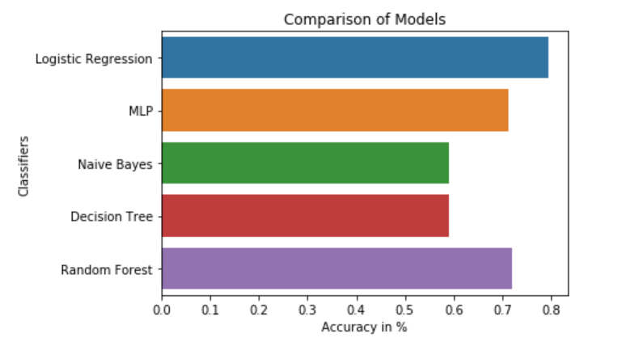
Comparison of Accuracy of models

